Slide 1
Inference in FOL
Inference in First-Order Logic is used to deduce new facts or sentences from existing sentences. Before understanding the FOL inference rule, let's understand some basic terminologies used in FOL.
Substitution:
Substitution is a fundamental operation performed on terms and formulas. It occurs in all inference systems in first-order logic. The substitution is complex in the presence of quantifiers in FOL. If we write F[a/x], so it refers to substitute a constant "a" in place of variable "x".

Slide 2
Equality:
First-Order logic does not only use predicate and terms for making atomic sentences but also uses another way, which is equality in FOL. For this, we can use equality symbols which specify that the two terms refer to the same object.
Example: Brother (John) = Smith.
As in the above example, the object referred by the Brother (John) is similar to the object referred by Smith. The equality symbol can also be used with negation to represent that two terms are not the same objects.
Example: ￢(x=y) which is equivalent to x ≠y.

Slide 3
FOL inference rules for quantifier:
As propositional logic we also have inference rules in first-order logic, so following are some basic inference rules in FOL:
Universal Generalization
Universal Instantiation
Existential Instantiation
Existential introduction

Slide 4
Universal Generalization
Universal generalization is a valid inference rule which states that if premise P(c) is true for any arbitrary element c in the universe of discourse, then we can have a conclusion as ∀ x P(x).
It can be represented as: .
This rule can be used if we want to show that every element has a similar property.
In this rule, x must not appear as a free variable.
Example: Let's represent, P(c): "A byte contains 8 bits", so for ∀ x P(x) "All bytes contain 8 bits.", it will also be true.

Slide 5

Universal Instantiation
Universal instantiation is also called as universal elimination or UI is a valid inference rule. It can be applied multiple times to add new sentences.
The new KB is logically equivalent to the previous KB.
As per UI, we can infer any sentence obtained by substituting a ground term for the variable.
The UI rule state that we can infer any sentence P(c) by substituting a ground term c (a constant within domain x) from ∀ x P(x) for any object in the universe of discourse.
It can be represented as:.

Slide 6
Example:1.
IF "Every person like ice-cream"=> ∀x P(x) so we can infer that "John likes ice-cream" => P(c)
Example: 2.
Let's take a famous example,
"All kings who are greedy are Evil." So let our knowledge base contains this detail as in the form of FOL:
∀x king(x) ∧ greedy (x) → Evil (x),
So from this information, we can infer any of the following statements using Universal Instantiation:
King(John) ∧ Greedy (John) → Evil (John),
King(Richard) ∧ Greedy (Richard) → Evil (Richard),
King(Father(John)) ∧ Greedy (Father(John)) → Evil (Father(John)),

Slide 7

Existential Instantiation:
Existential instantiation is also called as Existential Elimination, which is a valid inference rule in first-order logic.
It can be applied only once to replace the existential sentence.
The new KB is not logically equivalent to old KB, but it will be satisfiable if old KB was satisfiable.
This rule states that one can infer P(c) from the formula given in the form of ∃x P(x) for a new constant symbol c.
The restriction with this rule is that c used in the rule must be a new term for which P(c ) is true.
It can be represented as:
Example:

Slide 8
Example:
From the given sentence: ∃x Crown(x) ∧ OnHead(x, John),
So we can infer: Crown(K) ∧ OnHead( K, John), as long as K does not appear in the knowledge base.
The above used K is a constant symbol, which is called Skolem constant.
The Existential instantiation is a special case of Skolemization process.

Slide 9
4. Existential introduction
An existential introduction is also known as an existential generalization, which is a valid inference rule in first-order logic.
This rule states that if there is some element c in the universe of discourse which has a property P, then we can infer that there exists something in the universe which has the property P.
It can be represented as:
Example: Let's say that, "Priyanka got good marks in English." "Therefore, someone got good marks in English."

Slide 10
Generalized Modus Ponens Rule:
For the inference process in FOL, we have a single inference rule which is called Generalized Modus Ponens. It is lifted version of Modus ponens.
Generalized Modus Ponens can be summarized as, " P implies Q and P is asserted to be true, therefore Q must be True."
According to Modus Ponens, for atomic sentences pi, pi', q. Where there is a substitution θ such that SUBST (θ, pi',) = SUBST(θ, pi), it can be represented as:

Slide 11

Example:
We will use this rule for Kings are evil, so we will find some x such that x is king, and x is greedy so we can infer that x is evil.
Here let say, p1' is king(John) p1 is king(x)
p2' is Greedy(y) p2 is Greedy(x)
θ is {x/John, y/John} q is evil(x)
SUBST(θ,q).

Slide 12
Forward Chaining and backward chaining in AI
In artificial intelligence, forward and backward chaining is one of the important topics, but before understanding forward and backward chaining lets first understand that from where these two terms came.
Inference engine:
The inference engine is the component of the intelligent system in artificial intelligence, which applies logical rules to the knowledge base to infer new information from known facts. The first inference engine was part of the expert system. Inference engine commonly proceeds in two modes, which are:
Forward chaining
Backward chaining

Slide 13
Horn Clause and Definite clause:
Horn clause and definite clause are the forms of sentences, which enables knowledge base to use a more restricted and efficient inference algorithm. Logical inference algorithms use forward and backward chaining approaches, which require KB in the form of the first-order definite clause.
Definite clause: A clause which is a disjunction of literals with exactly one positive literal is known as a definite clause or strict horn clause.

Slide 14
Horn clause: A clause which is a disjunction of literals with at most one positive literal is known as horn clause. Hence all the definite clauses are horn clauses.
Example: (¬ p V ¬ q V k). It has only one positive literal k.
It is equivalent to p ∧ q → k.

Slide 15
Forward Chaining
Forward chaining is also known as a forward deduction or forward reasoning method when using an inference engine.
Forward chaining is a form of reasoning which start with atomic sentences in the knowledge base and applies inference rules (Modus Ponens) in the forward direction to extract more data until a goal is reached.
The Forward-chaining algorithm starts from known facts, triggers all rules whose premises are satisfied, and add their conclusion to the known facts.
This process repeats until the problem is solved.

Slide 16
Properties of Forward-Chaining:
It is a down-up approach, as it moves from bottom to top.
It is a process of making a conclusion based on known facts or data, by starting from the initial state and reaches the goal state.
Forward-chaining approach is also called as data-driven as we reach to the goal using available data.
Forward -chaining approach is commonly used in the expert system, such as CLIPS, business, and production rule systems.

Slide 17
Example
"As per the law, it is a crime for an American to sell weapons to hostile nations. Country A, an enemy of America, has some missiles, and all the missiles were sold to it by Robert, who is an American citizen."
Prove that "Robert is criminal."
To solve the above problem, first, we will convert all the above facts into first-order definite clauses, and then we will use a forward-chaining algorithm to reach the goal.

Slide 18
Facts Conversion into FOL:
It is a crime for an American to sell weapons to hostile nations. (Let's say p, q, and r are variables) American (p) ∧ weapon(q) ∧ sells (p, q, r) ∧ hostile(r) → Criminal(p) ...(1)
Country A has some missiles. ?p Owns(A, p) ∧ Missile(p). It can be written in two definite clauses by using Existential Instantiation, introducing new Constant T1. Owns(A, T1) ......(2) Missile(T1) .......(3)
All of the missiles were sold to country A by Robert. ?p Missiles(p) ∧ Owns (A, p) → Sells (Robert, p, A) ......(4)

Slide 19
Missiles are weapons. Missile(p) → Weapons (p) .......(5) Enemy of America is known as hostile. Enemy(p, America) →Hostile(p) ........(6) Country A is an enemy of America. Enemy (A, America) .........(7) Robert is American American(Robert). ..........(8)

Slide 20
Forward chaining proof:
Step-1:
In the first step we will start with the known facts and will choose the sentences which do not have implications, such as: American(Robert), Enemy(A, America), Owns(A, T1), and Missile(T1). All these facts will be represented as below.

Slide 21

Step-2:
At the second step, we will see those facts which infer from available facts and with satisfied premises.
Rule-(1) does not satisfy premises, so it will not be added in the first iteration.
Rule-(2) and (3) are already added.
Rule-(4) satisfy with the substitution {p/T1}, so Sells (Robert, T1, A) is added, which infers from the conjunction of Rule (2) and (3).
Rule-(6) is satisfied with the substitution(p/A), so Hostile(A) is added and which infers from Rule-(7).

Slide 22
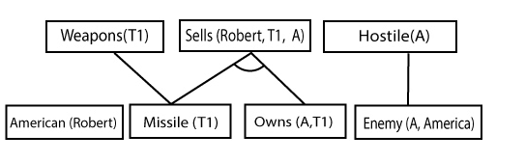
Step-3:
At step-3, as we can check Rule-(1) is satisfied with the substitution {p/Robert, q/T1, r/A}, so we can add Criminal(Robert) which infers all the available facts. And hence we reached our goal statement.

Slide 23
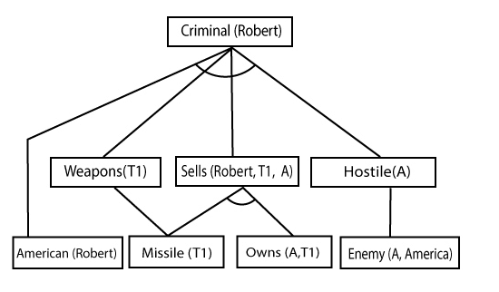
Hence it is proved that Robert is Criminal using forward chaining approach.

Slide 24
Backward Chaining
Backward-chaining is also known as a backward deduction or backward reasoning method when using an inference engine.
A backward chaining algorithm is a form of reasoning, which starts with the goal and works backward, chaining through rules to find known facts that support the goal.

Slide 25
Properties of backward chaining
It is known as a top-down approach.
Backward-chaining is based on modus ponens inference rule.
In backward chaining, the goal is broken into sub-goal or sub-goals to prove the facts true.
It is called a goal-driven approach, as a list of goals decides which rules are selected and used.
Backward -chaining algorithm is used in game theory, automated theorem proving tools, inference engines, proof assistants, and various AI applications.
The backward-chaining method mostly used a depth-first search strategy for proof.

Slide 26
Example
In backward-chaining, we will use the same above example, and will rewrite all the rules.
American (p) ∧ weapon(q) ∧ sells (p, q, r) ∧ hostile(r) → Criminal(p) ...(1) Owns(A, T1) ........(2)
Missile(T1) ........(3)
Missiles(p) ∧ Owns (A, p) → Sells (Robert, p, A) ......(4)
Missile(p) → Weapons (p) .......(5)
Enemy(p, America) →Hostile(p) ........(6)
Enemy (A, America) .........(7)
American(Robert). ..........(8)

Slide 27

Backward-Chaining proof
In Backward chaining, we will start with our goal predicate, which is Criminal(Robert), and then infer further rules.
Step-1:
At the first step, we will take the goal fact. And from the goal fact, we will infer other facts, and at last, we will prove those facts true. So our goal fact is "Robert is Criminal," so following is the predicate of it.

Slide 28
Step-2
At the second step, we will infer other facts form goal fact which satisfies the rules.
So as we can see in Rule-1, the goal predicate Criminal (Robert) is present with substitution {Robert/P}.
So we will add all the conjunctive facts below the first level and will replace p with Robert.

Slide 29
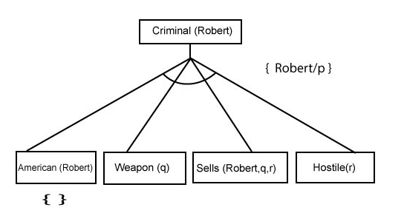
Here we can see American (Robert) is a fact, so it is proved here.

Slide 30
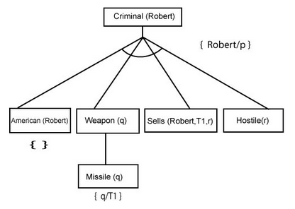
Step-3
At step-3, we will extract further fact Missile(q) which infer from Weapon(q), as it satisfies Rule-(5). Weapon (q) is also true with the substitution of a constant T1 at q.

Slide 31
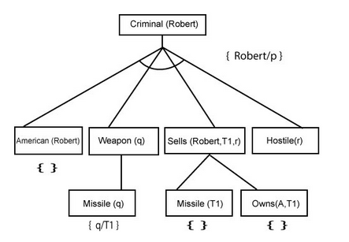
Step-4
At step-4, we can infer facts Missile(T1) and Owns(A, T1) form Sells(Robert, T1, r) which satisfies the Rule- 4, with the substitution of A in place of r. So these two statements are proved here.

Slide 32
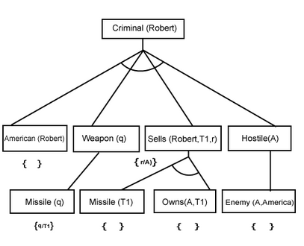
Step-5
At step-5, we can infer the fact Enemy(A, America) from Hostile(A) which satisfies Rule- 6. And hence all the statements are proved true using backward chaining.

